Slide 1



Restaurant Analysis Project
Project By – Bhushan Dhawas
Portfolio Website – (Link)
Email – bdhawas0016@gmail.com
Mobile – 9075252543

Slide 2

TABLE OF CONTENT
Introduction to Zomato
Project Aim
Data Overview
Key Statistics
Data Cleaning and Processing
Methodology
Market Research
Dashboard
Recommendations
Conclusion

Slide 3
Introduction To Zomato
History
Zomato was founded in 2008 as a restaurant discovery platform in India. It started as a website that provided information about restaurants, including menus, reviews, and ratings.
Mission
Zomato's mission is to ensure that everyone can find and enjoy great food. They aim to connect users with the best dining experiences by providing accurate and comprehensive information about restaurants.
User Base
Zomato has a large and diverse user base, with millions of active users worldwide. It is available in multiple countries and supports multiple languages, making it accessible to a global audience.

Slide 4
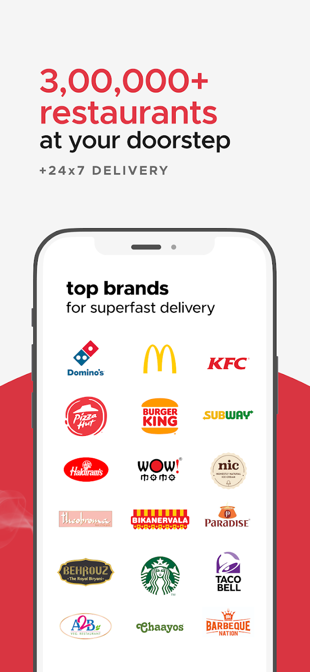
Project Aim
To identify optimal countries and cities for opening new restaurants by analysing existing restaurant performance, market demand, and economic factors, ensuring profitable and strategic expansion.

Slide 5
Data Overview
Restaurant ID: Unique identifier for each restaurant.
Restaurant Name: The name of the restaurant.
CountryCode: Country code of the location where the restaurant is situated.
City: The city where the restaurant is located.
Address: The specific address of the restaurant.
Locality: The locality or neighborhood where the restaurant is situated.
Locality Verbose: Detailed information about the locality.
Longitude: The geographical longitude coordinate of the restaurant.
Latitude: The geographical latitude coordinate of the restaurant.
Updated_Cuisines: The type of cuisine offered by the restaurant.
Currency: The currency used for transactions in the restaurant.
Price: The cost of two people dining with respective currency symbol.
Price in USD: The Price has been converted to USD.
Price in RS: The Price has been converted to INR.
Has_Table_booking: Indicates whether the restaurant has a table booking option (Yes/No).
Has_Online_delivery: Indicates whether the restaurant offers online delivery (Yes/No).
Is_delivering_now: Indicates whether the restaurant is currently delivering (Yes/No).
Switch_to_order_menu: Indicates whether users can switch to the order menu (Yes/No).
Price_range: A numeric value indicating the price range category of the restaurant.
Votes: The number of votes or ratings/(feedback) received by the restaurant.
Average_Cost_for_two: The average cost for two people dining at the restaurant.
Rating: The overall rating of the restaurant is based on user reviews.
Updated_Datekey_opening: The date when the restaurant was opened.
Years: The year of restaurant opened.
Country: The country of restaurant located.

Slide 6

Key Statistics
Total Number of Restaurants: 9,551 restaurants from various countries around the world.
Total Number of Cuisines: 1,825 cuisines from various restaurants across different countries and states.
Total Number of Cities: 141 cities have been analysed from 15 countries.
Total Number of Votes: 1,498,645 votes were cast in the review system to generate feedback.

Slide 7

Data Cleaning and Processing
Treated the missing values in the 'Cuisines' column for the USA.
Standardized the date format.
Processed various currencies and converted them into INR and USD for comparison.
Created new columns for year, month, and quarter from the date for better visualization.
Merged the respective currency with its associated cost using string operations.
Used LOOKUP functions to fetch the appropriate country codes.

Slide 8

Methodology
Missing value treatment:- Using pivot table, Taking top 5 Cuisines count , Sorting in Descending order, ISBLANK function, IF function.
Data Enrichment:- Enhanced the data set with additional variables using VLOOKUP, MID, FIND, CONCAT, TEXT, DATEVALUE, SUBSTITUTE, YEAR, MONTH, ROUNDUP and connecting tables to cross reference with original data source.
Descriptive Analysis:- Employed Pivot tables for summarizing key metrices, conditional aggregational functions and normal excel functions (count, if, etc.) for analyzing objective questions.
Executive Segmentations:- Applied year and country wise filters to analyse the various outcomes of ratings, prices etc. for different countries at a different timeline.
Data Visualization:- Created dynamic charts and Dashboard for data representation, enabling interactive data exploration.

Slide 9
Market Research
The highest number of restaurants opened in the year 2018, followed by 2011 and 2017.
After 2011, there was a drop in the number of openings, followed by another drop in 2015, after which the number began to rise consistently.

Slide 10
Market Research
Chart displays the number of restaurants in each country of the dataset.
India is having the highest number of restaurants i.e. 8652
Second place is occupied by USA with 434 restaurants.
Canada is at the last of the graph indicating least number of restaurants i.e. 4

Slide 11
Market Research
Indonesia is having the highest number of voters in restaurants, followed by UAE, USA AND Philippines.
Brazil has a lowest number of voters in restaurants, followed by Singapore.
As compare to number of restaurants in India, the number of voters are very less.

Slide 12
Market Research
Singapore, the Philippines, and the United Kingdom have significantly higher expenditure management costs, making them more challenging for budget control.
In contrast, Sri Lanka, Turkey, India, Indonesia, and South Africa have much lower expenditure management costs. For our filtered countries, with an average expenditure below 30, we can effectively manage and control our budget.

Slide 13
Market Research
Based on the visualization North Indian, Chinese, Fast Food, Mughlai, and Café are among the top 10 cuisines, favoured for their high ratings and frequent presence.
For our optimized countries, the most recommendable cuisines to include in our menu are Cafe, Indian, American, Italian, Chinese, and Dessert.

Slide 14
Market Research
We can able to the analysis that the selected country are having better rating above 3.9
Philippines – 4.5
New Zealand – 4.3
Qatar – 4.1
South Africa – 4.2
Sri Lanka – 3.9
Turkey - 4.3
United Arab Emirate – 4.2

Slide 15
Market Research
New Zealand, Singapore, and the UAE have a significant portion of restaurants in price range 1, which helps in managing expenditure effectively.
Consider focusing on these markets to maintain cost control while expanding.

Slide 16
Market Research
Among the records, 1,158 entries (12%) offer a table booking option, with limited adoption across countries.
Similar to online delivery, providing table booking services is associated with higher ratings, reflecting positive customer feedback.
Countries like Qatar, the United Arab Emirates, and South Africa have notable support for table booking, contributing to their strong ratings.

Slide 17
Market Research
Out of the total records, 2,451 entries (around 26%) offer an online booking option, with limited support across countries.
Implementing or enhancing online delivery services tends to result in higher ratings, indicating positive customer response to this feature.
Notably, in the United Arab Emirates, 47% of the entries (28 records) support online delivery, which correlates with good ratings.

Slide 18
TOP COUNTRIES FOR NEW RESTAURANT OPENING
Most suitable countries (cities) for opening new restaurants based on criteria where total number of restaurants are less than 100, average ratings are higher than or equals to 3.9, with less than 60 USD average expenditure for two person to have a meal and number of voters higher than 150, are :
South Africa: Cape Town, Johannesburg, Pretoria, Randburg, Sandton
Sri Lanka: Colombo
Turkey: Ankara, Istanbul
News Zealand: Auckland, Wellington City
Qatar: Doha
UAE: Abu Dhabi, Sharjah

Slide 19
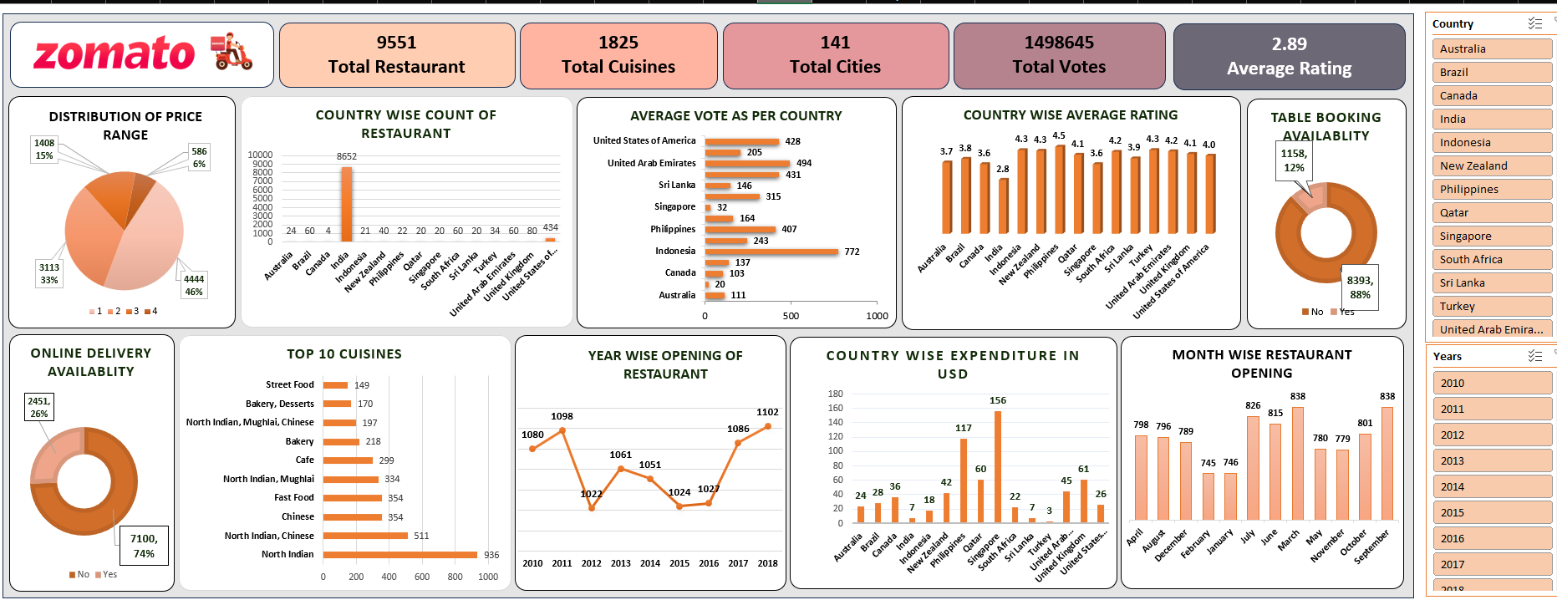
DASHBOARD

Slide 20
RECOMMENDATION
The selected countries and cities are based on the following criteria: each has fewer than 100 existing restaurants, average ratings of 3.9 or higher, an average expenditure of less than $60 for two people, and a minimum of 150 voters. These factors indicate strong market potential and favourable conditions for new restaurant openings.
South Africa: Cities like Cape Town, Johannesburg, Pretoria, Randburg, and Sandton are ideal for new restaurants, with a strong customer base and high average ratings.
Sri Lanka: Colombo stands out as a prime location, meeting all criteria for restaurant expansion with favourable ratings and manageable expenditure.
Turkey: Ankara and Istanbul are highly suitable, offering good ratings and reasonable costs, making them strategic choices for new ventures.
New Zealand: Auckland and Wellington City are recommended for their balanced restaurant numbers, high ratings, and lower expenditure, making them attractive for growth.
Qatar and UAE: Doha, Abu Dhabi, and Sharjah present excellent opportunities, combining high customer engagement and favourable conditions for new restaurant openings.

Slide 21
CONCLUSION
In conclusion, our analysis of Zomato restaurant data reveals promising opportunities for strategic expansion across the globe. By targeting regions with high demand, catering to specific demographic preferences, and capitalizing on competitive advantages, we can confidently recommend the opening of new restaurants. This initiative not only enhances market presence but also delivers exceptional dining experiences, driving sustainable growth for Zomato and enriching the global culinary landscape.

Slide 22

Portfolio website : (Link)
Email : bdhawas0016@gmail.com
Mobile no. – 9075252543
LinkedIn : (Link)

